Slide 1
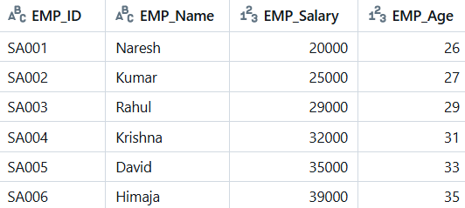
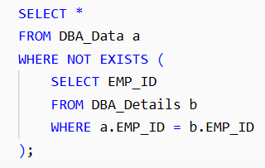

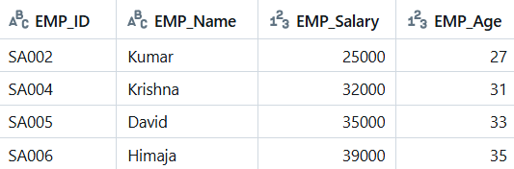
Using NOT EXISTS
DBA_Data
DBA_Details

Slide 2


Using LEFT JOIN ... IS NULL
DBA_Data
DBA_Details

Slide 3

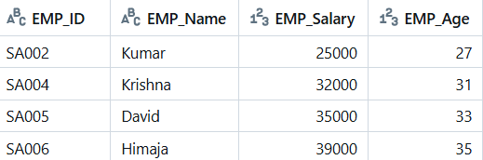

Slide 4
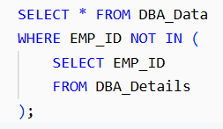
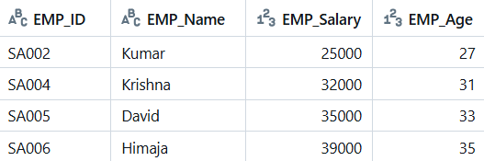
Using NOT IN
DBA_Data
DBA_Details

